Slide 1
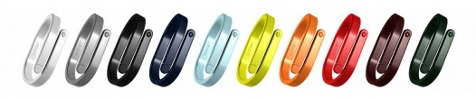
Cicret Bracelet

Slide 2
INTRODUCTION
It is a simple wrist band integrated with a pico–projector.
Just twist your wrist and your device turns into a Smartphone .
It makes your skin a new TOUCH SCREEN.
It’s a Prototype model.
We can Read mails, play favorite games, answer calls, check the weather, find way... Do whatever we want on our arm.

Slide 3
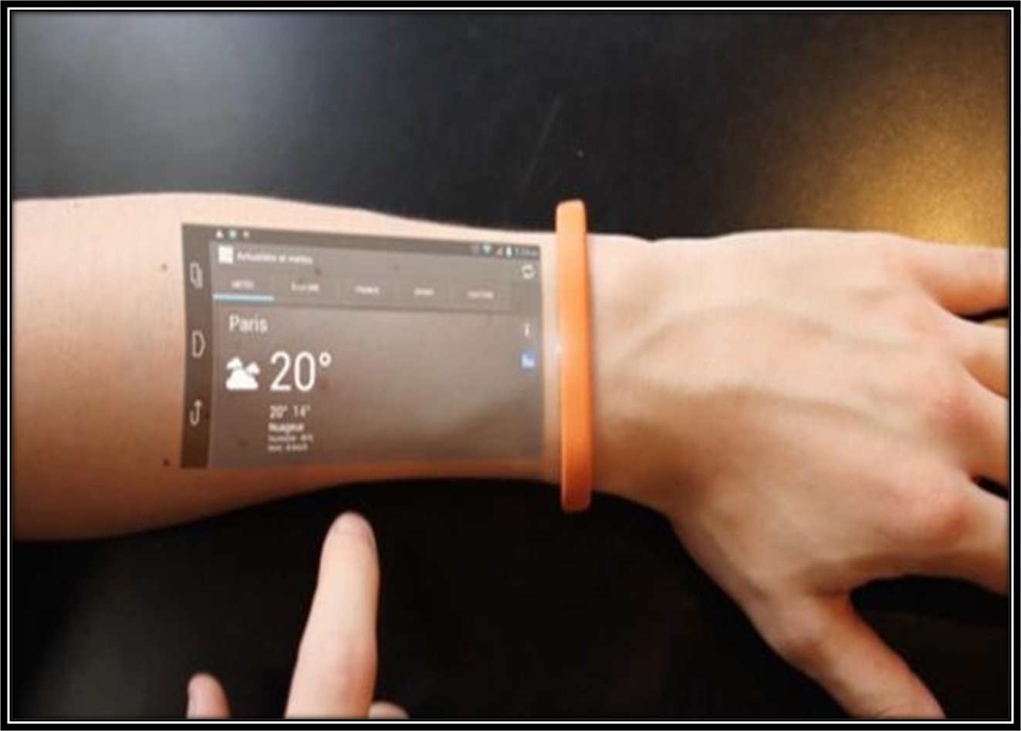

Slide 4
HOW IT WORKS ?
It comes with a row of eight proximity sensors pointing towards the user’s forearm.
The Pico Projector projects the interface on your arm. When we place our finger, the long-range proximity sensor intercepts your movements, sending the information back to the processor (in your Cicret Bracelet).
Cicret's futuristic features include an accelerometer and a vibration module, LED for notifications, WiFi, Bluetooth, and a Micro USB port.

Slide 5
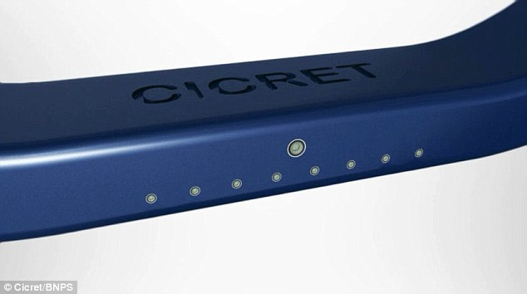

Slide 6
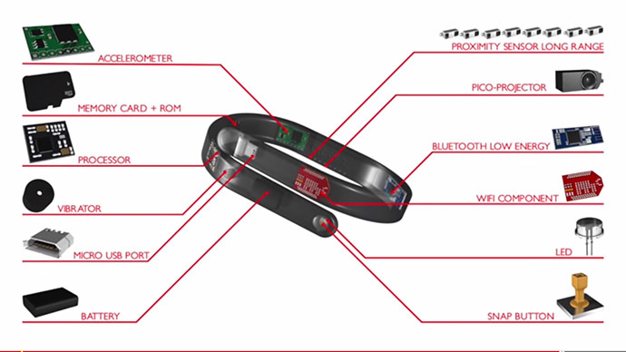
STRUCTURE

Slide 7
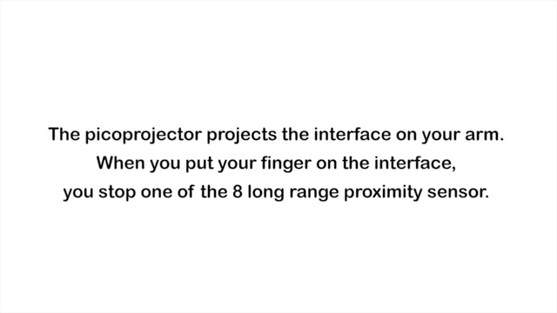
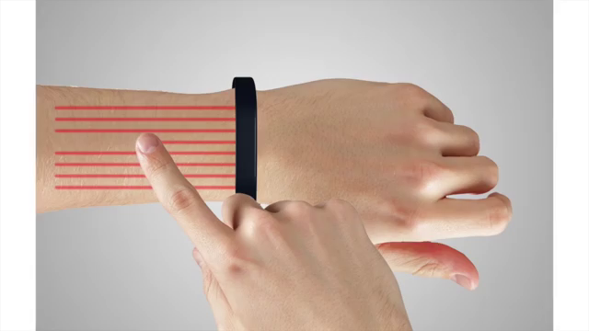
HOW IT WORKS ?

Slide 8
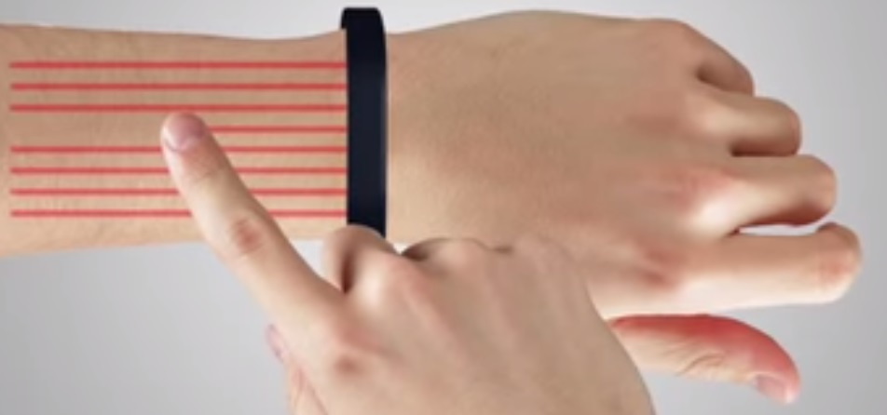
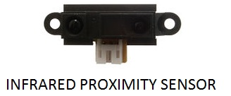
HOW IT WORKS ?
Proximity Sensor Emits electromagnetic field/ beam
Looks for change in field/return signal When hand placed : stops one of the 8 sensor and sends information back to the processor

Slide 9
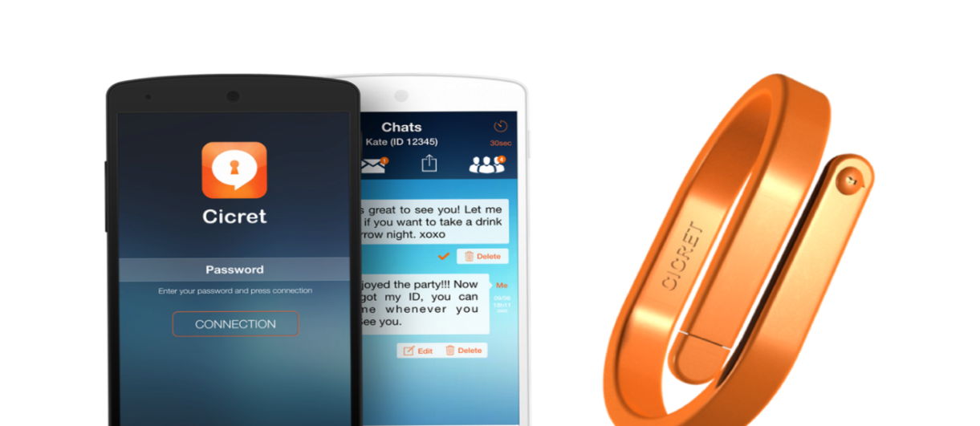
HOW TO OPERATE ?
we can turn on Cicret which is connected to a mobile device via the Cicret app.
It connects through WIFI or Bluetooth.
It could operate as a standalone device and can also be paired with your existing Smartphone. This means, users can perform all functions using a large screen display without the need to pull out their phones.

Slide 10
KEY FEATURES
The band is waterproof and can be used as a standalone device or along with the Smartphone.
We can
send and receive emails
browse the web
play games
Cicret Bracelet will allow you to access almost all the functions from your arm without holding the gadget every time.

Slide 11
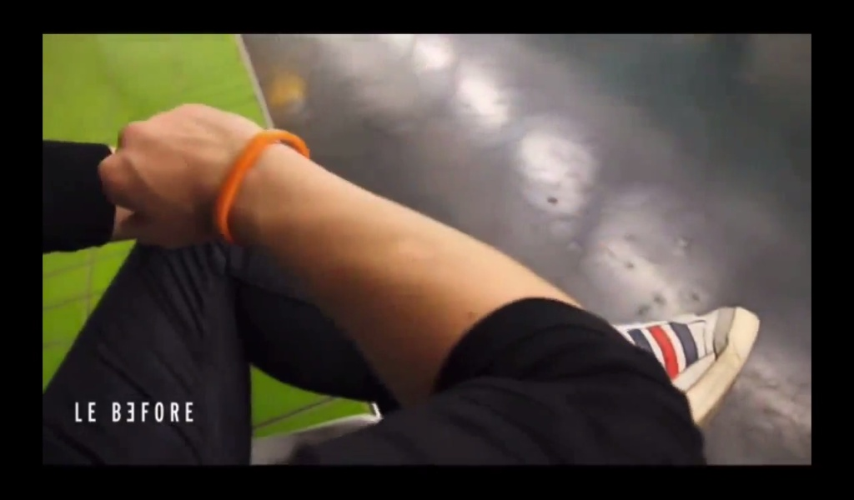
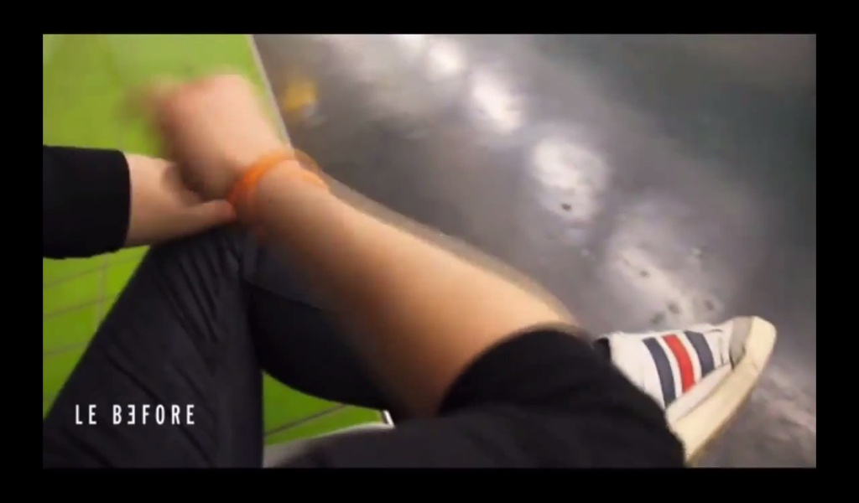
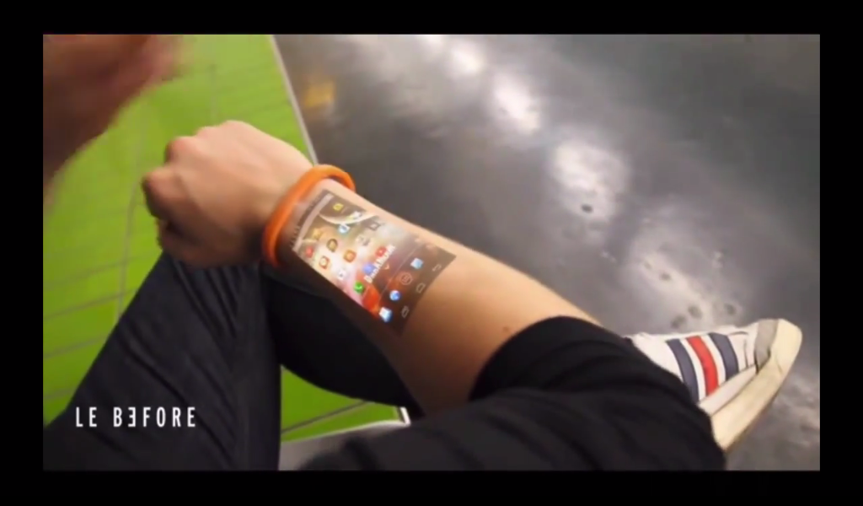
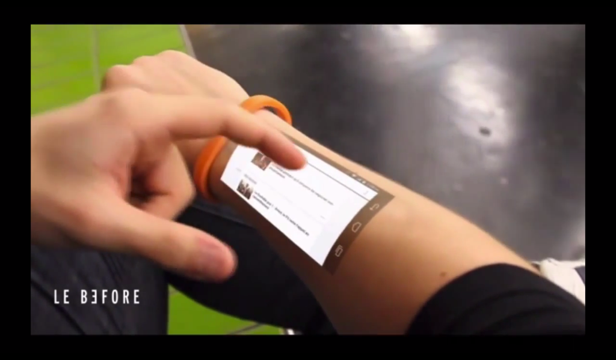
1
2
3
4

Slide 12
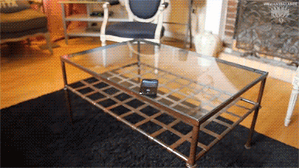
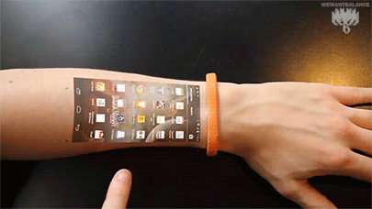
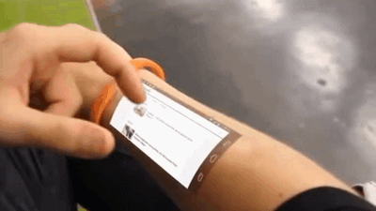
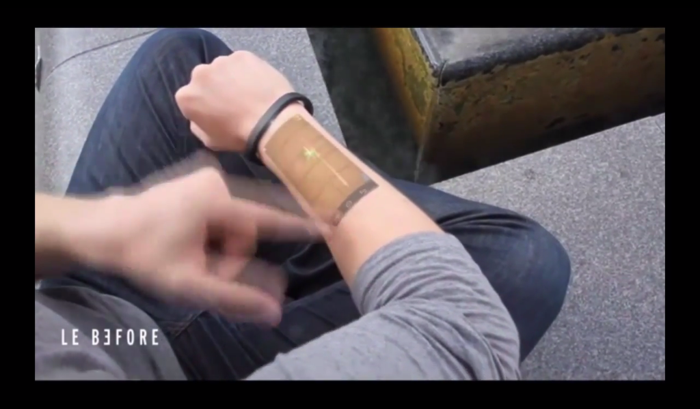
MAKE CALLS
WEATHER
REPORT
BROWSE WEB
PLAY GAMES

Slide 13
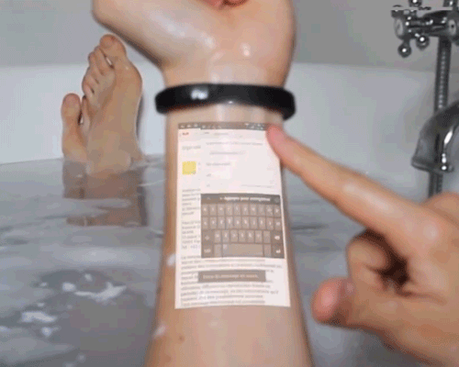
WATERPROOF

Slide 14
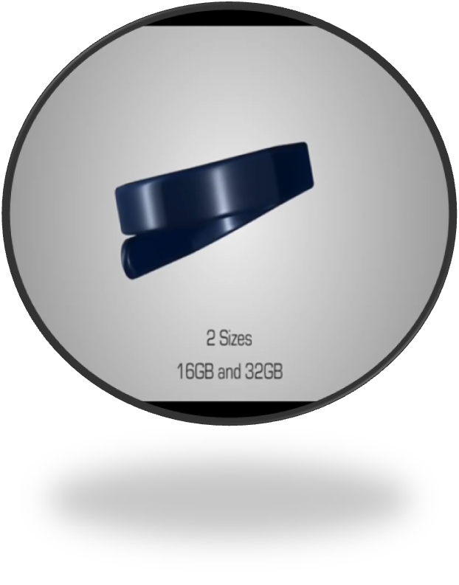
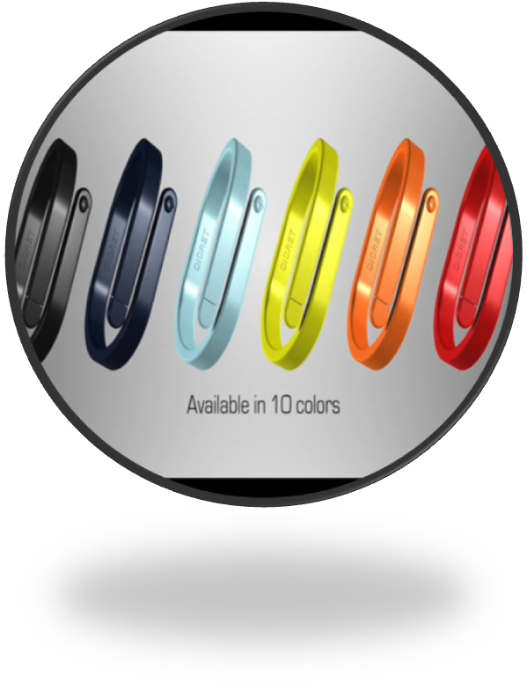
It is available in 10 different colors and 2 sizes of 16GB & 32GB

Slide 15
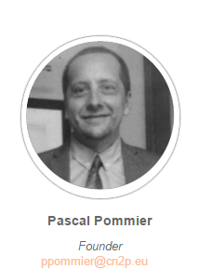
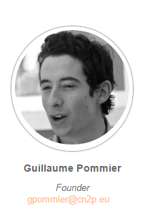
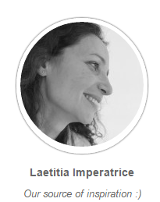
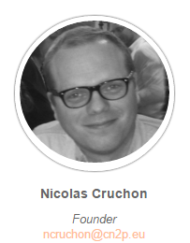
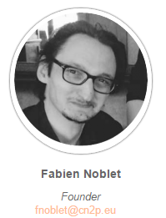
Founders of CICRET

Slide 16
Conclusion
These type of device
will help in
development of many sectors in a developing
country

Slide 17
ANY QUIRIES
23.12.2020 г.

Slide 18
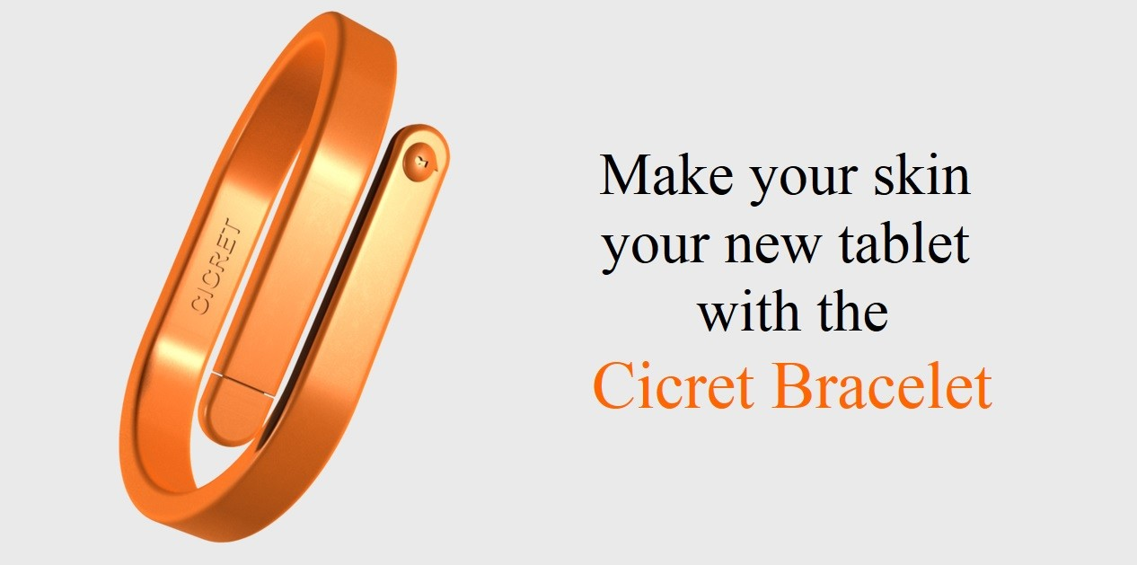
Thank You

